Slide 1
Forest Fire Simulation – Weather and Topographical Related Factors
Antonio Jordan
CSC 59866 – Senior Project Design I

Slide 2
Stochastic Modeling and Cellular Automata
Stochastic Models - used to estimate the probability of various outcomes while allowing for randomness in one or more inputs over time
A forest fire is modeled as a stochastic event with an effective fire spread probability which is a function of three probabilities that characterize:
The proportion of trees on the grid
The probability of a tree being set on fire
The probability of the fire spreading to another tree
Cellular Automaton:
Grid of cells
Set of states each cell can be in
Set of rules to determine evolution of each system

Slide 3
Our Model/Cellular Automaton
Grid of 100x100 cells
Empty, Tree/Fuel, or Fire/Burning state
Four rules:
An empty cell becomes a tree at probability tree_growth
A tree cell becomes a burning cell if at least one of its neighbors is a burning cell
A tree cell will ignite at probability lightning_strike even if no neighbor is burning (lightning or human error)
A burning cell becomes an empty cell

Slide 4
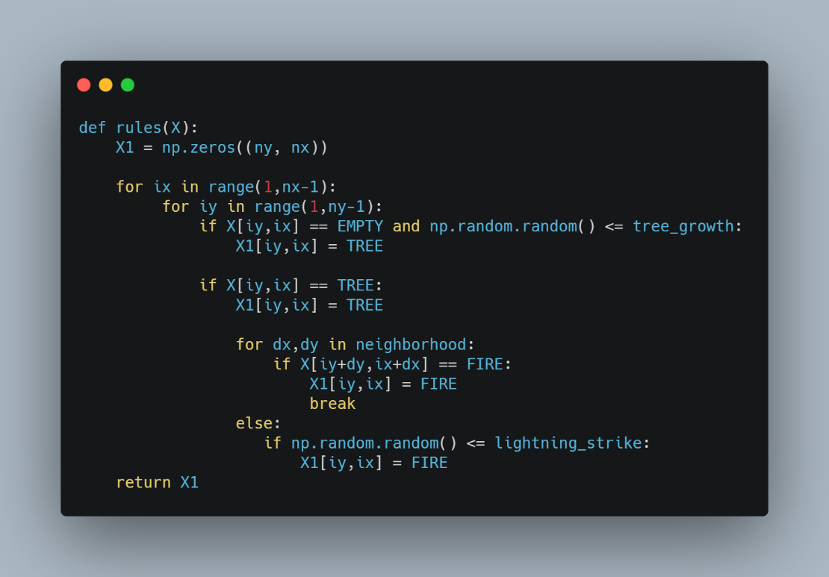
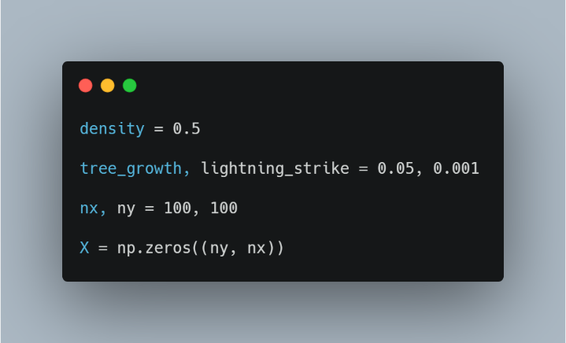
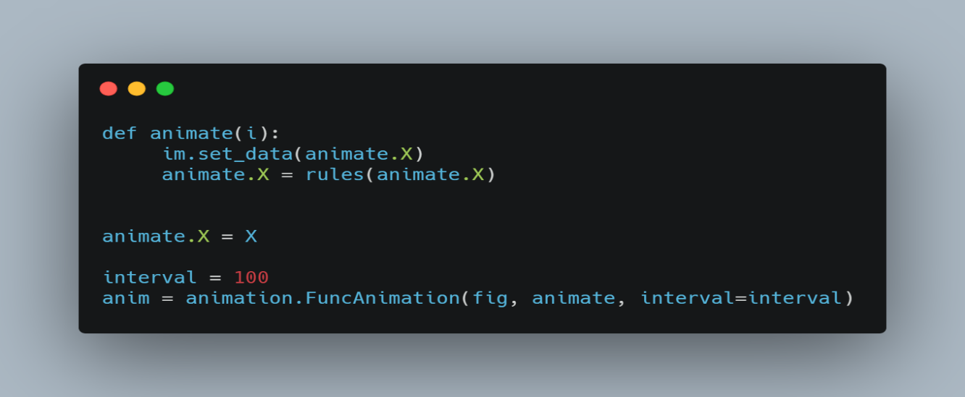
Simple Forest Fire: Implementation

Slide 5
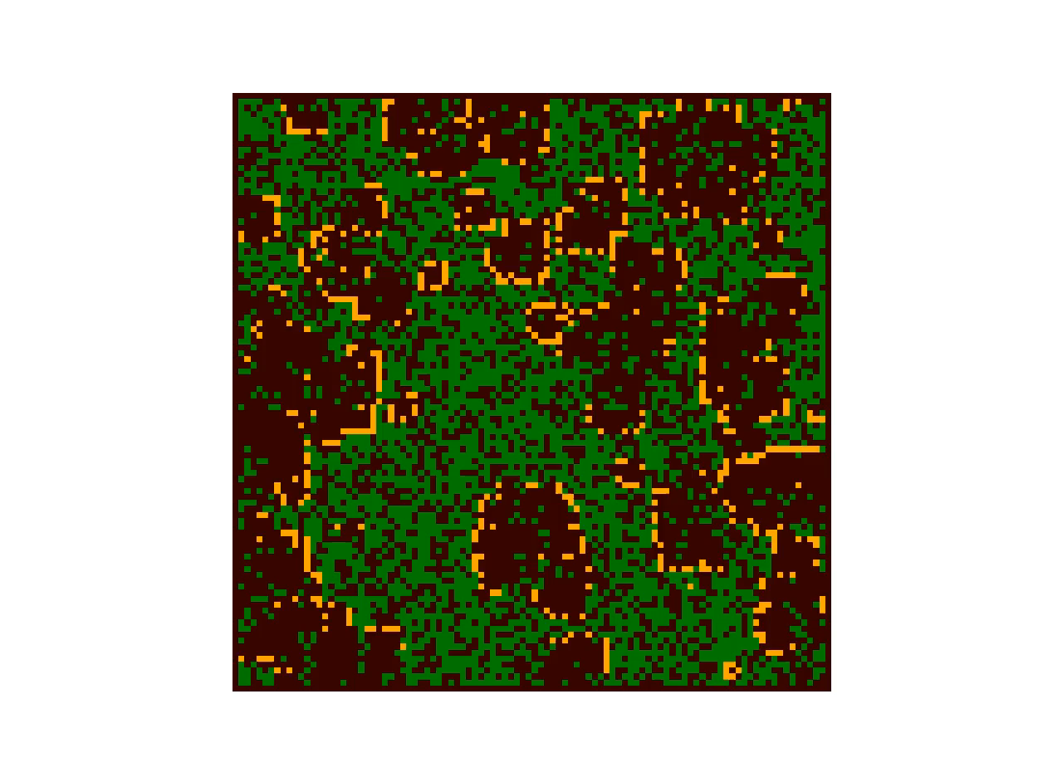
Idealized Forest Fire: No Factors

Slide 6


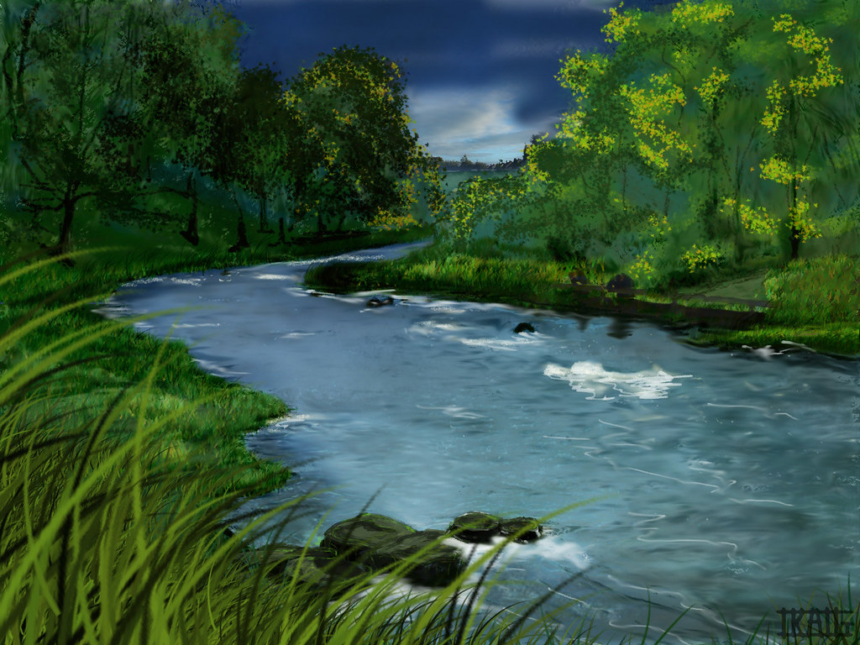
Additional Factors
Weather and Topographical Factors
Wind
Temperature
Slope
Barriers
Humidity

Slide 7
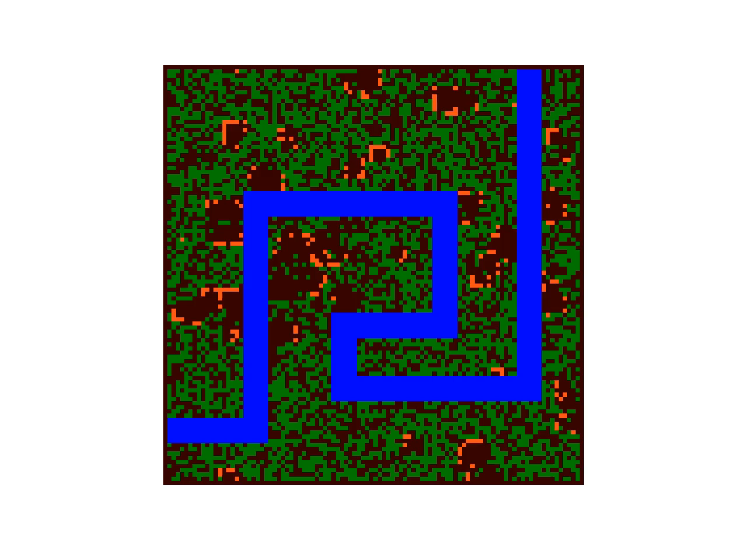
Barrier Model
Goal: Fire spread can be impeded by barriers
Add blue to color list
Created rule such that water cells don’t change
Define river cells

Slide 8
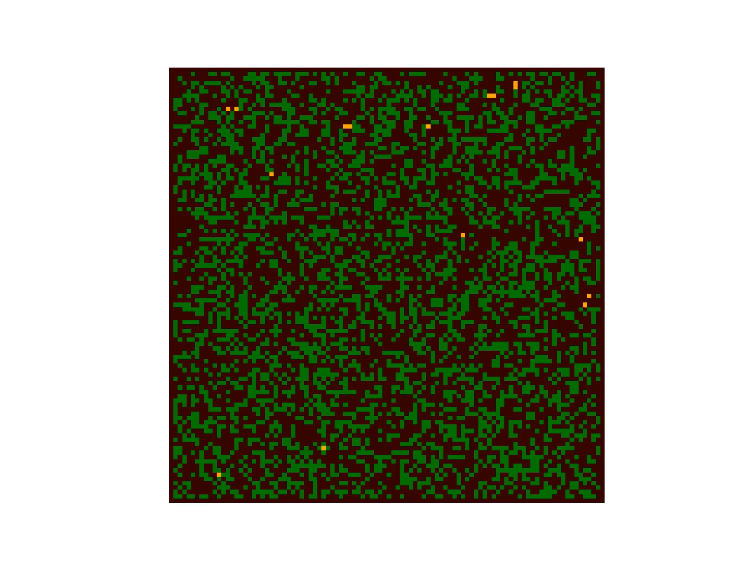
Wind Model
Goal: Fire spreads faster in the direction the wind is blowing
Modified neighborhood
Change to rules

Slide 9
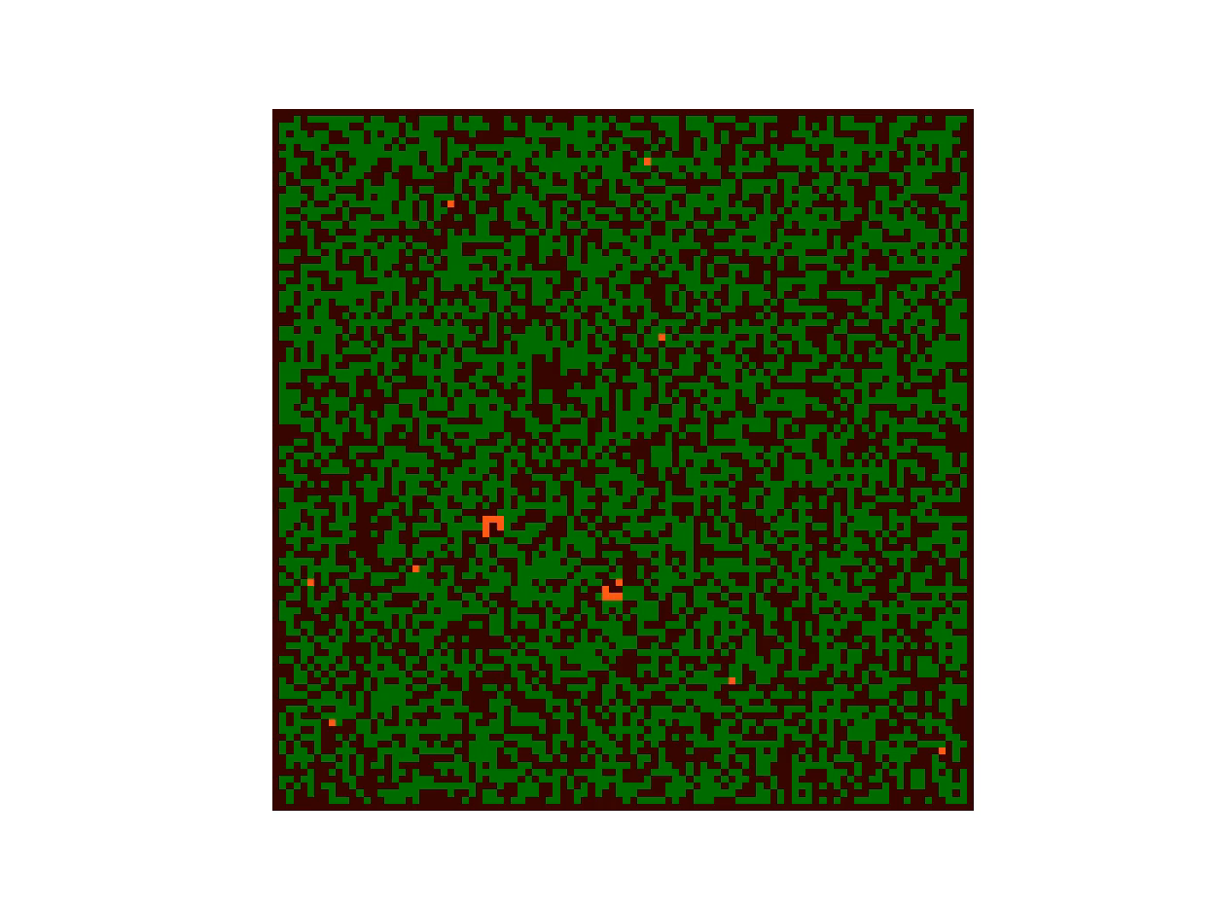
Temperature Model
Goal: Fire spreads faster at higher temperatures
Added colors (Orange, Red, Purple, Blue)
Manipulated interval parameter

Slide 10
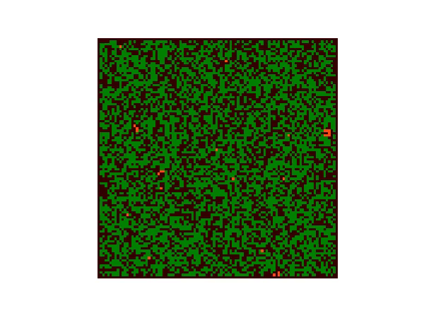
Humidity Model
Goal: High humidity and rain can slow or stop fire spread
Added probability for rain
Added rule to slow fire spread

Slide 11
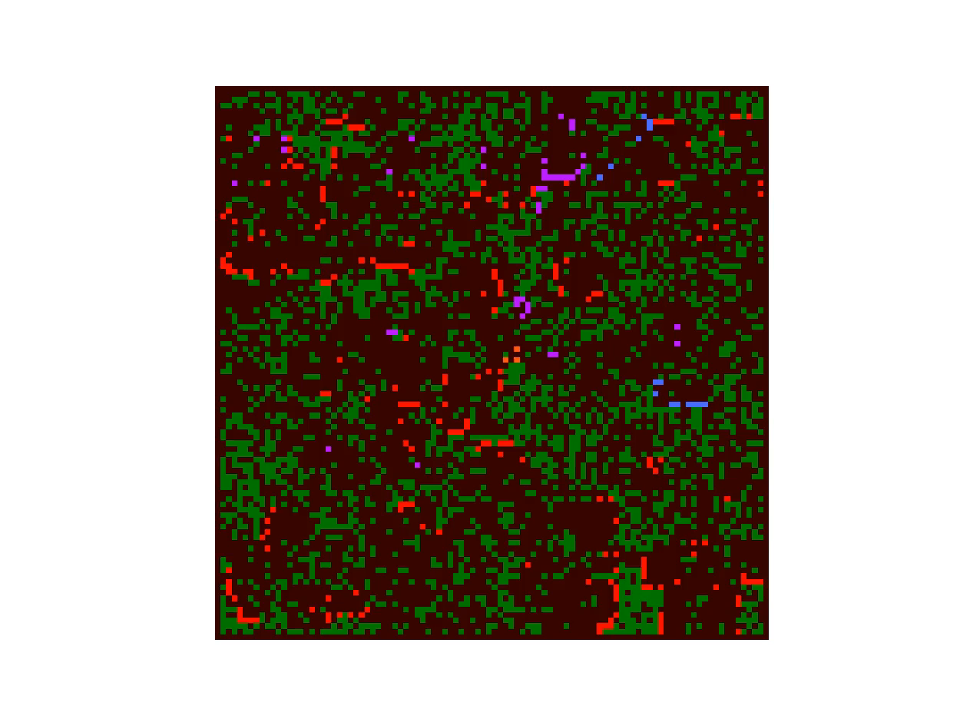
Combination of Factors
Temperature and humidity
Adjusting interval
Temperature, barriers, and wind
Spotting – chance of fire “jumping” barrier

Slide 12
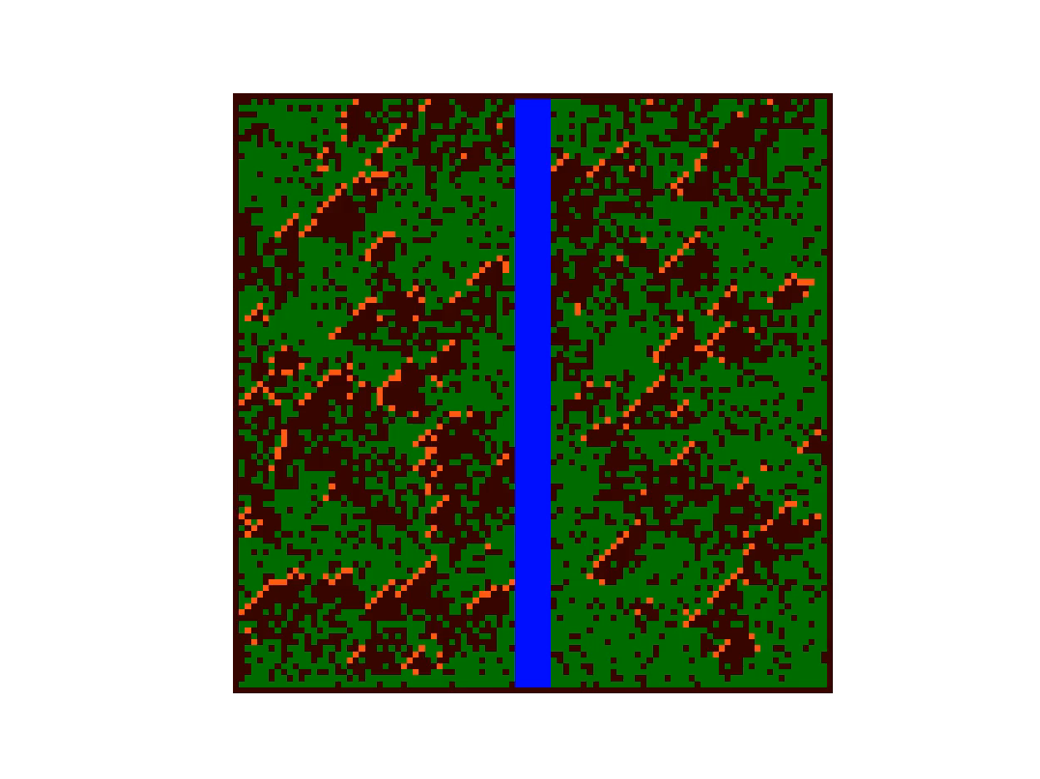
Temperature, Wind, and Barriers

